Slide 1
Chapter 6
Sharing Resources on a Network

Slide 2
Object
• Explain how to use peer-to-peer networking in a home or office
• Configure Windows 7 UNIX/Linux and Mac OS X for peer-to-peer networking
• Configure user accounts • Configure folder and file sharing
• Configure printer sharing • Use Internet connection sharing
• Explain cloud computing • Explain virtual private networks
• Explain storage area networks
• Design a peer-to-peer office network to share resources
http://fpt.edu.vn

Slide 3
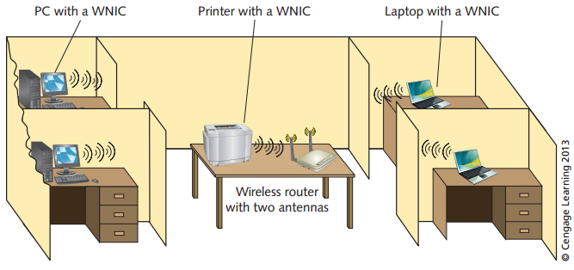
What Is Peer-to-Peer Networking?
The simplest ways to configure a network
Used for home offices and small businesses
Used to share resources such as files and printers and to connect to resources on other computers.
- Easy to set up
- It is inexpensive to maintain
- It is simple in concept
Decentralized
Security
Administration
http://fpt.edu.vn
Notes:
Read carefully the scenario in Chapter 6

Slide 4
What Is Peer-to-Peer Networking?
Peer-to-peer networking offers only moderate network security, as user account information must be managed on each workstation.
There is no centralized storage of information for account management
Network management becomes more difficult because there is no central administrative software
Peer-to-peer networks can experience slow response because this model is not optimized for multiple users accessing one computer
http://fpt.edu.vn

Slide 5
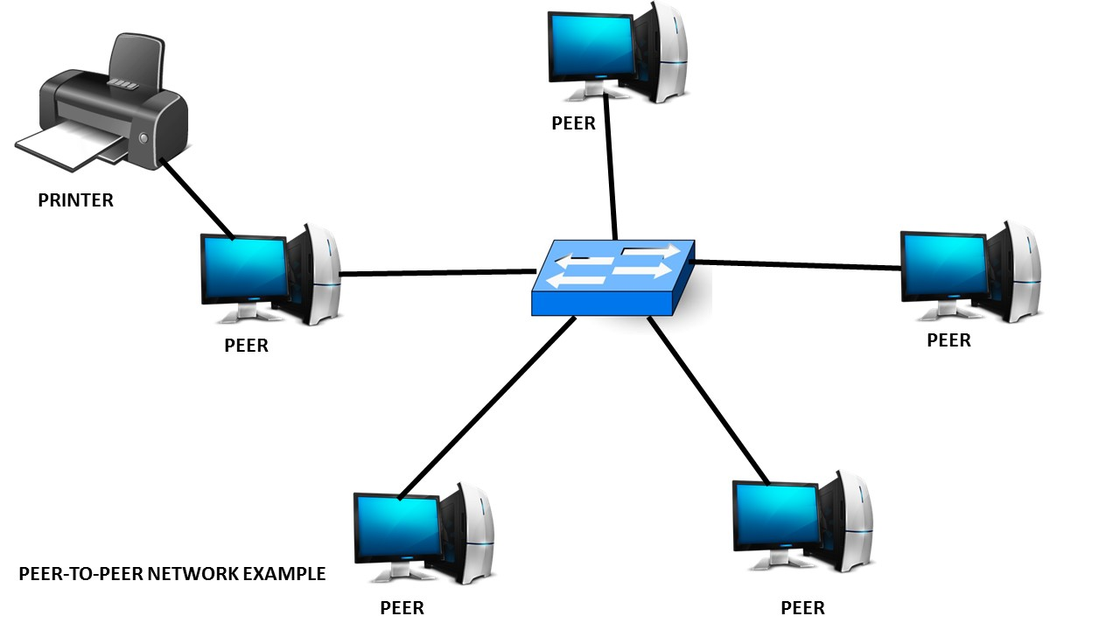
What Is Peer-to-Peer Networking?
Peer-to-Peer Networking for Home Use
Peer-to-Peer Networking for Office Use
http://fpt.edu.vn

Slide 6
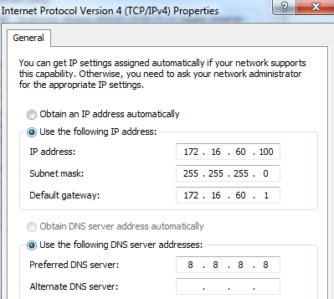
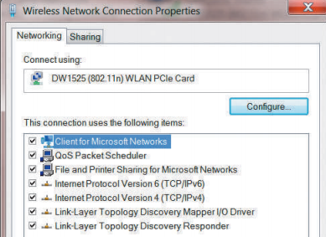
Configuring Windows-Based Computers for Peer-to-Peer Networking
Elements for peer-to-peer computing
  Client for Microsoft Networks is installed
  TCP/IP is installed and configured
  File and Printer Sharing for Microsoft Networks is set up
  A homegroup or workgroup is configured
http://fpt.edu.vn

Slide 7
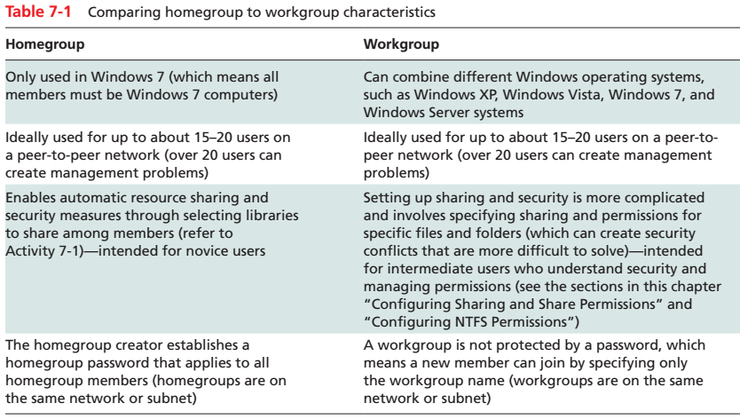
Using Workgroups in Windows
Uses workgroups to identify computers and other resources on a network
Uses workgroups to identify computers and other resources on a network
Access shared resources on a different computer
http://fpt.edu.vn

Slide 8
UNIX/Linux/ Mac OS peer-to-peer
UNIX/Linux application called Samba
  Network FileSystem
  Server Message Block (SMB) protocol
Apple’s AirPort wireless approach
  802.11b/g/n wireless connectivity at 2.4 or 5 GHz
  connect up to 50 users
http://fpt.edu.vn

Slide 9
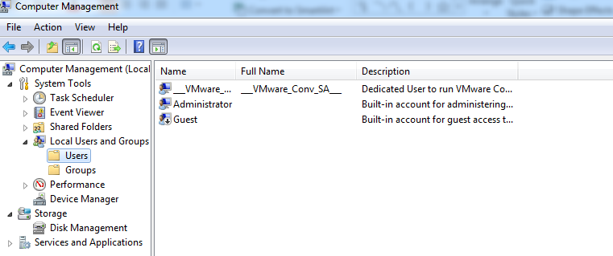
Configuring User Accounts
The user account is central to authentication of users for access to specific resources
Authorized to access a particular computer, server, network, or network resource
http://fpt.edu.vn

Slide 10
Configuring Accounts in UNIX/Linux
Each user account in UNIX/Linux is associated with a user identification number (UID)
can be assigned to a group via a group identification number (GID)
/etc/passwd and /etc/shadow contains the information
http://fpt.edu.vn

Slide 11
Sharing Files and Folders in Windows 7
Elements to sharing and accessing files and folders in Windows 7:
  Configuring sharing and share permissions
  Configuring NTFS permissions
  Accessing a share folder
Configuring Sharing and Share Permissions
  Nobody
  Homegroup (Read)
  Homegroup (Read/Write)
  Specific people
http://fpt.edu.vn

Slide 12
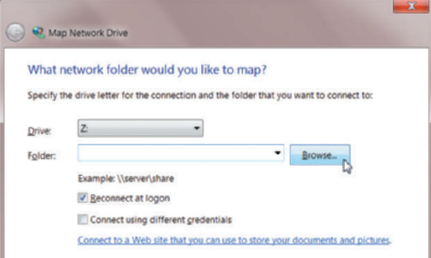
Accessing and Sharing Resources in Windows 7
Mapping is a software process that enables a client workstation to attach to the shared folder of another workstation or server and assign it a drive letter
In UNIX/Linux is a mapped drive is called a mounted volume
http://fpt.edu.vn

Slide 13
Configuring Sharing in UNIX/Linux
A directory or file can be assigned any combination of
three permissions:
  Read
  Write
  Execute
http://fpt.edu.vn

Slide 14
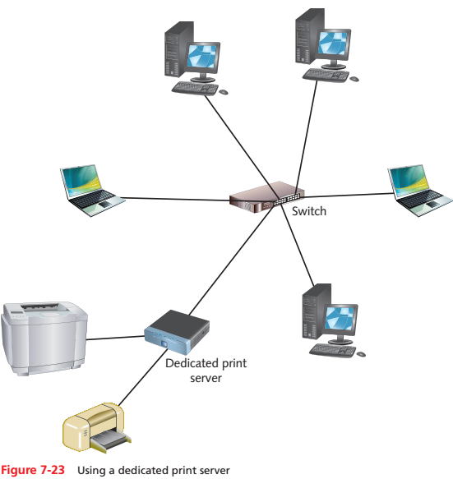
Sharing Printers
There are several common ways to implement network printing:
  By using a network-ready printer that has a WNIC or NIC
  By using a dedicated print server
  By sharing a printer through an operating system connected to the network
http://fpt.edu.vn

Slide 15
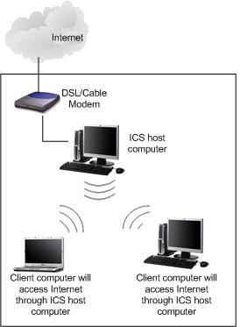
Shared Internet Access
The computer configured for ICS needs an Internet connection
Ensure that file and printer sharing is enabled on the computer with ICS
Do not configure ICS on a network that has servers running DHCP or DNS to avoid confusion about IP addressing
http://fpt.edu.vn

Slide 16

Cloud Computing
Definition from NIST (National Institute of Standards and Technology)
  Cloud computing is a model for enabling convenient, on-demand network access to a shared pool of configurable computing resources (e.g., networks, servers, storage, applications, and services) that can be rapidly provisioned and released with minimal management effort or service provider interaction.
  This cloud model promotes availability and is composed of five essential characteristics, three service models, and four deployment models.
http://fpt.edu.vn

Slide 17
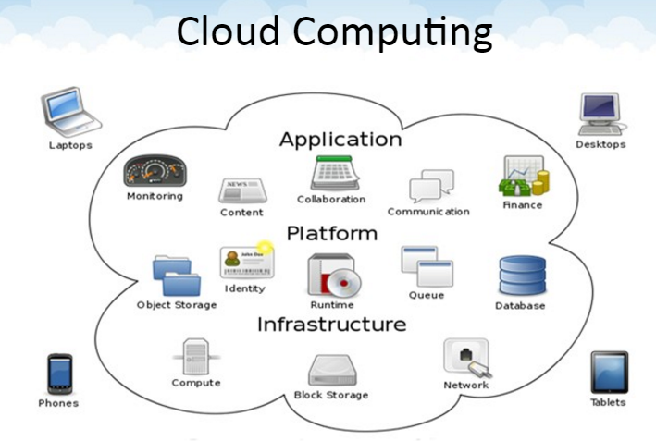
http://fpt.edu.vn

Slide 18
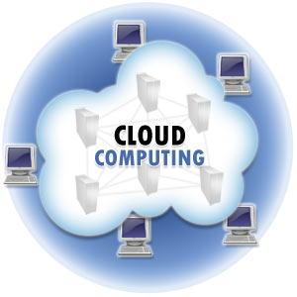
Cloud Computing
Cloud computing is a paradigm of computing, a new way of thinking about IT industry but not any specific technology.
  Central ideas
    Utility Computing
    SOA - Service Oriented Architecture
    SLA - Service Level Agreement
  Properties and characteristics
    High scalability and elasticity
    High availability and reliability
    High manageability and interoperability
    High accessibility and portability
    High performance and optimization
  Enabling techniques
    Hardware virtualization
    Parallelized and distributed computing
    Web service
http://fpt.edu.vn

Slide 19
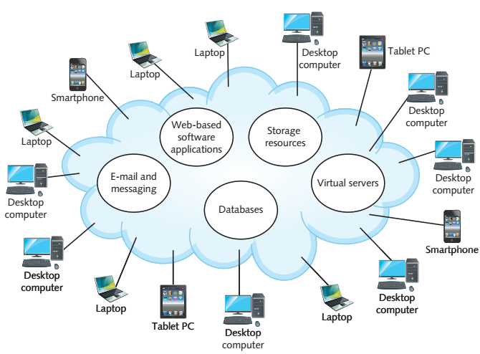
Cloud Computing
Web-based applications
Three types of cloud models
  Private cloud
  Hosted private cloud
  Public cloud
Vendors: Google, Microsoft, Apple, amazon
http://fpt.edu.vn

Slide 20
Cloud Computing
Developing cloud computing concepts that are helpful to know are the following:
  Communication as a Service (CaaS)
  Desktop as a Service (DaaS)
  Infrastructure as a Service (IaaS)
  Monitoring as a Service (MaaS)
  Network as a Service (NaaS)
  Platform as a Service (PaaS)
  Software as a Service (SaaS)
  Anything or Everything as a Service (XaaS)
http://fpt.edu.vn

Slide 21
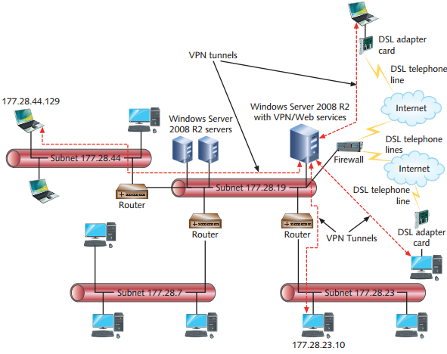
Implementing a Virtual Private Network
A virtual private network (VPN) is a private network that is like a private tunnel through a larger network
A VPN can use an Internet connection or an internal network connection to connect with a VPN server
Security: IP security (IPsec)
http://fpt.edu.vn

Slide 22
Who uses VPN’s?
VPN’s can be found in homes, workplaces, or anywhere else as long as an ISP (Internet Service Provider) is available.
VPN’s allow company employees who travel often or who are outside their company headquarters to safely and securely connect to their company’s Intranet
http://fpt.edu.vn

Slide 23
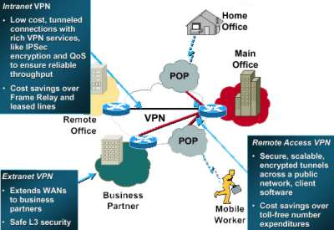
Types of VPN
Remote-Access VPN
  virtual private dial-up network (VPDN), is a user-to-LAN connection used by a company that has employees who need to connect to the private network from various remote locations.
Site-to-Site VPN (Intranet-based)
  If a company has one or more remote locations that they wish to join in a single private network, they can create an intranet VPN to connect LAN to LAN
Site-to-Site VPN (Extranet-based)
  When a company has a close relationship with another company (for example, a partner, supplier or customer), they can build an extranet VPN that connects LAN to LAN, and that allows all of the various companies to work in a shared environment
http://fpt.edu.vn

Slide 24
VPN Protocols
PPTP (Point-to-point tunneling protocol )
  PPTP is widely supported by Microsoft as it is built into the various flavors of the Windows OS
  PPTP initially had weak security features, however, Microsoft continues to improve its support
L2TP (Layer Two tunneling protocol )
  L2TP was the original competitor to PPTP and was implemented primarily in Cisco products
  L2TP is a combination of the best features of an older protocol L2F and PPTP
  L2TP exists at the datalink layer (Layer 2) of the OSI model
Ipsec (Internet Protocol Security Protocol )
  provides enhanced security features such as better encryption algorithms and more comprehensive authentication
  two encryption modes: tunnel and transport
http://fpt.edu.vn

Slide 25

http://fpt.edu.vn

Slide 26
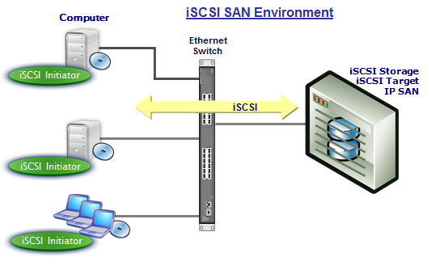
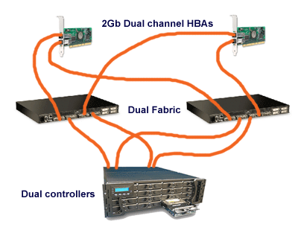
Storage Area Networks
Storage areamnetwork (SAN): grouping of storage devices that forms a subnet
Uses Fibre Channel or iSCSI technology
http://fpt.edu.vn

Slide 27
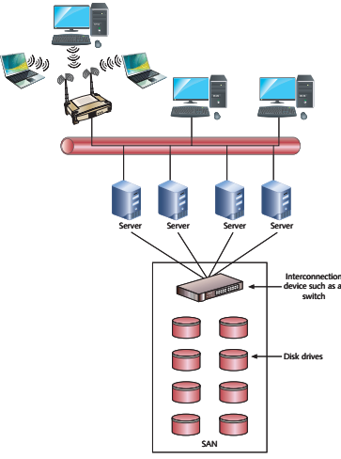
Storage Area Networks
http://fpt.edu.vn

Slide 28
Q & A
http://fpt.edu.vn

